Slide 1
Configure Amazon Lightsail
October 2022

Slide 2
What is Amazon Lightsail?
“Amazon Lightsail is a virtual private server (VPS) provider and is the easiest way to get started with AWS for developers, small businesses, students, and other users who need a solution to build and host their applications on cloud.”
You can interact with Amazon Lightsail through the console, command line interface (CLI), or API to create and manage instances.

Slide 3
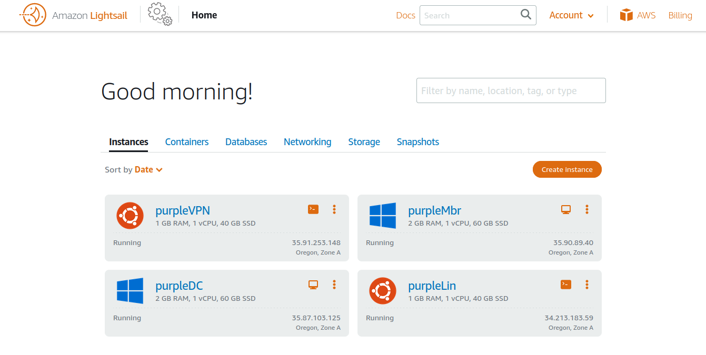
Amazon Lightsail Console (LC)
Lab Setup
2 Linux Instances
2 Win Instances
OpenVPN connection *(Security Concern)
Linux Web Server
WinDC and Win Member Server

Slide 4
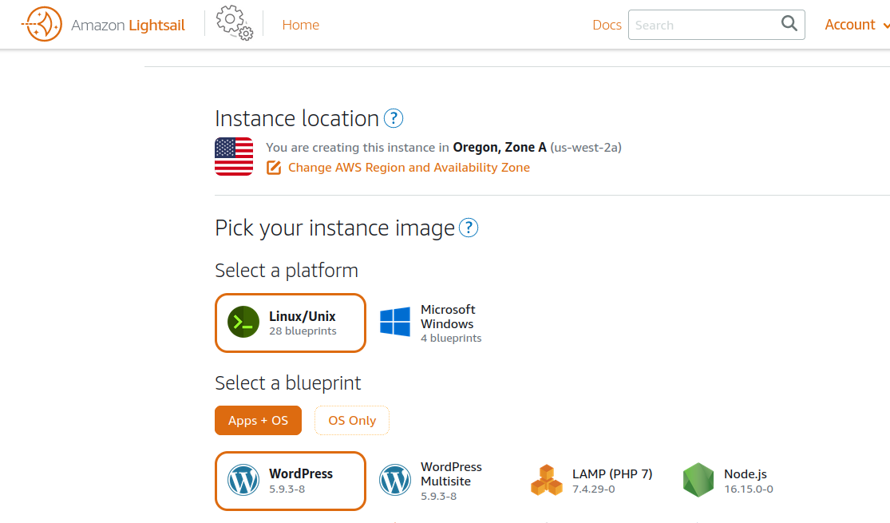
LC - Create an Instance (Location - Blueprints)

Slide 5
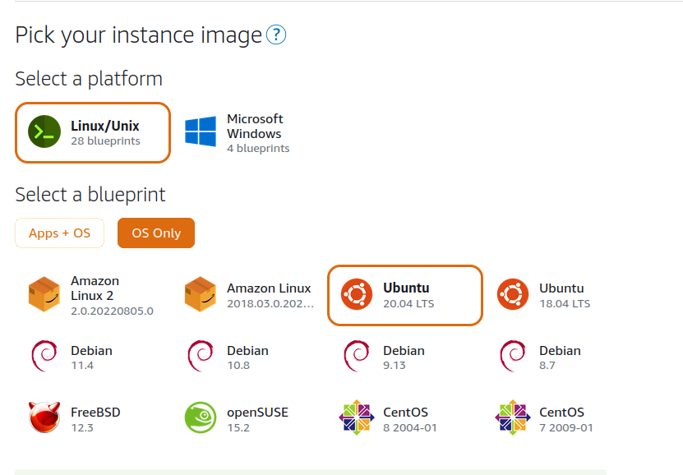
LC - Create an Instance (OS Only)

Slide 6
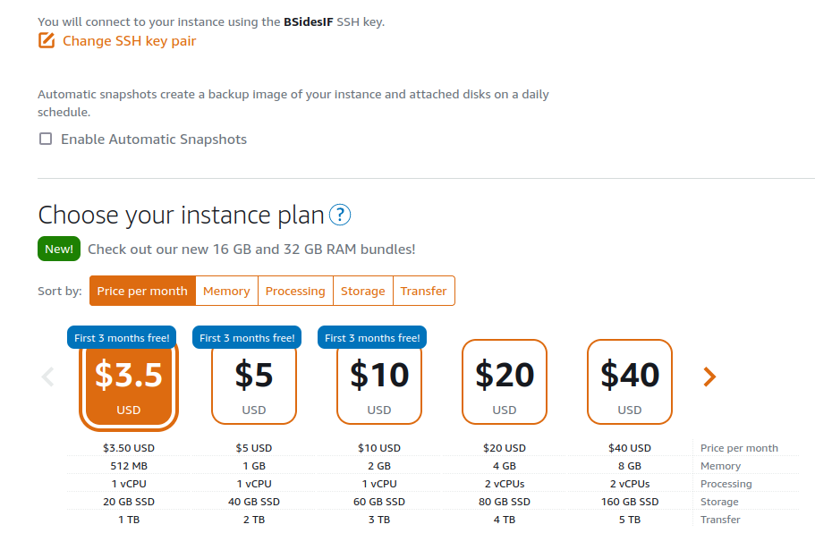
LC - Create an Instance (Linux SSH and Plan)
SSH Key Pair (Default vs. Created)
Automatic Snapshots ($)
Instance Plan (Read about the 3 months free)

Slide 7
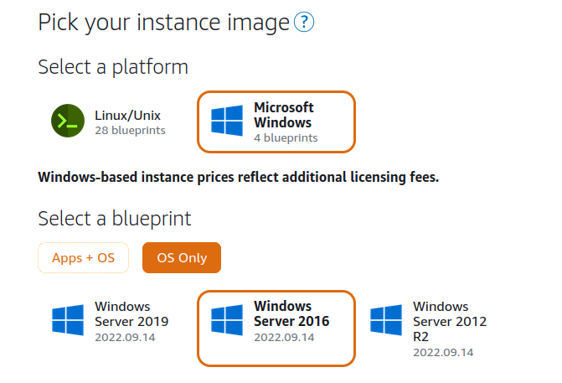
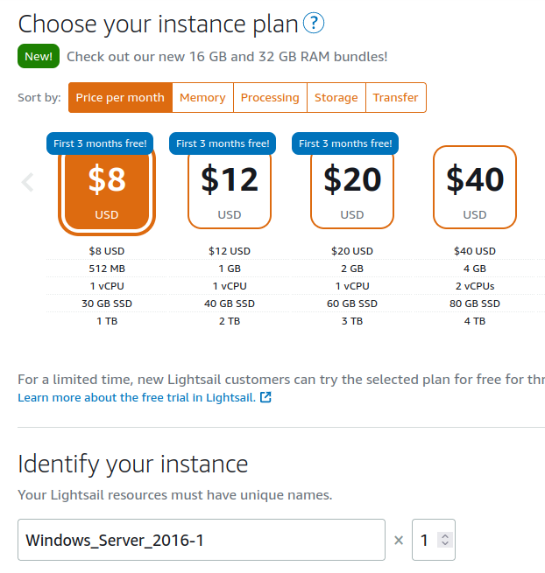
LC - Create an Instance (Win)
Windows OS
Instance Plan and Cost
Name your Instance

Slide 8
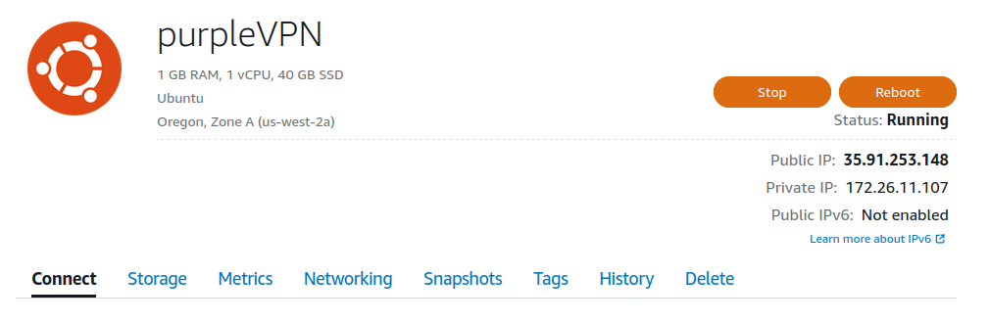
LC - Configure Instance
Name
Location
Delete
Public IP
Private IP (They can talk internally - not continuous)
IPv6 enabled by Default

Slide 9
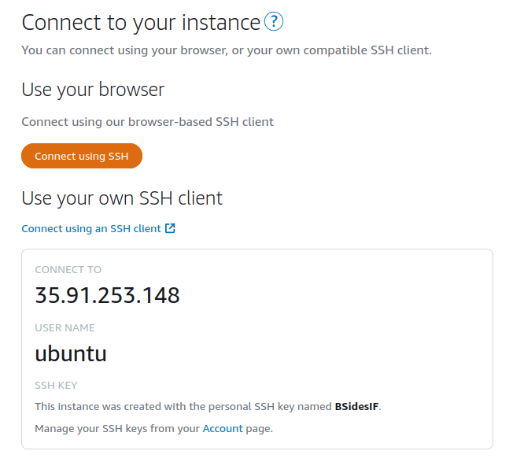
LC - Configure Instance - Connecting
Browser Connection
Use SSH Client (Ansible)
Default Username
SSH Key Utilized

Slide 10
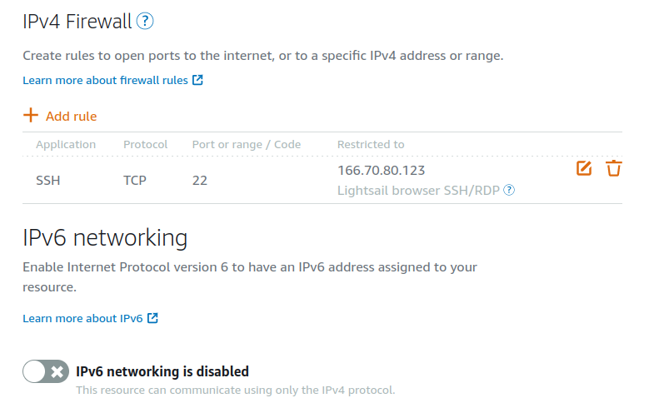
LC - Configure Networking (Linux)
IPv4 Firewall applies to Public IP Address
Adding Rules
Restrict to IP Address Range
IPv6 Network (Disable?)

